Slide 1

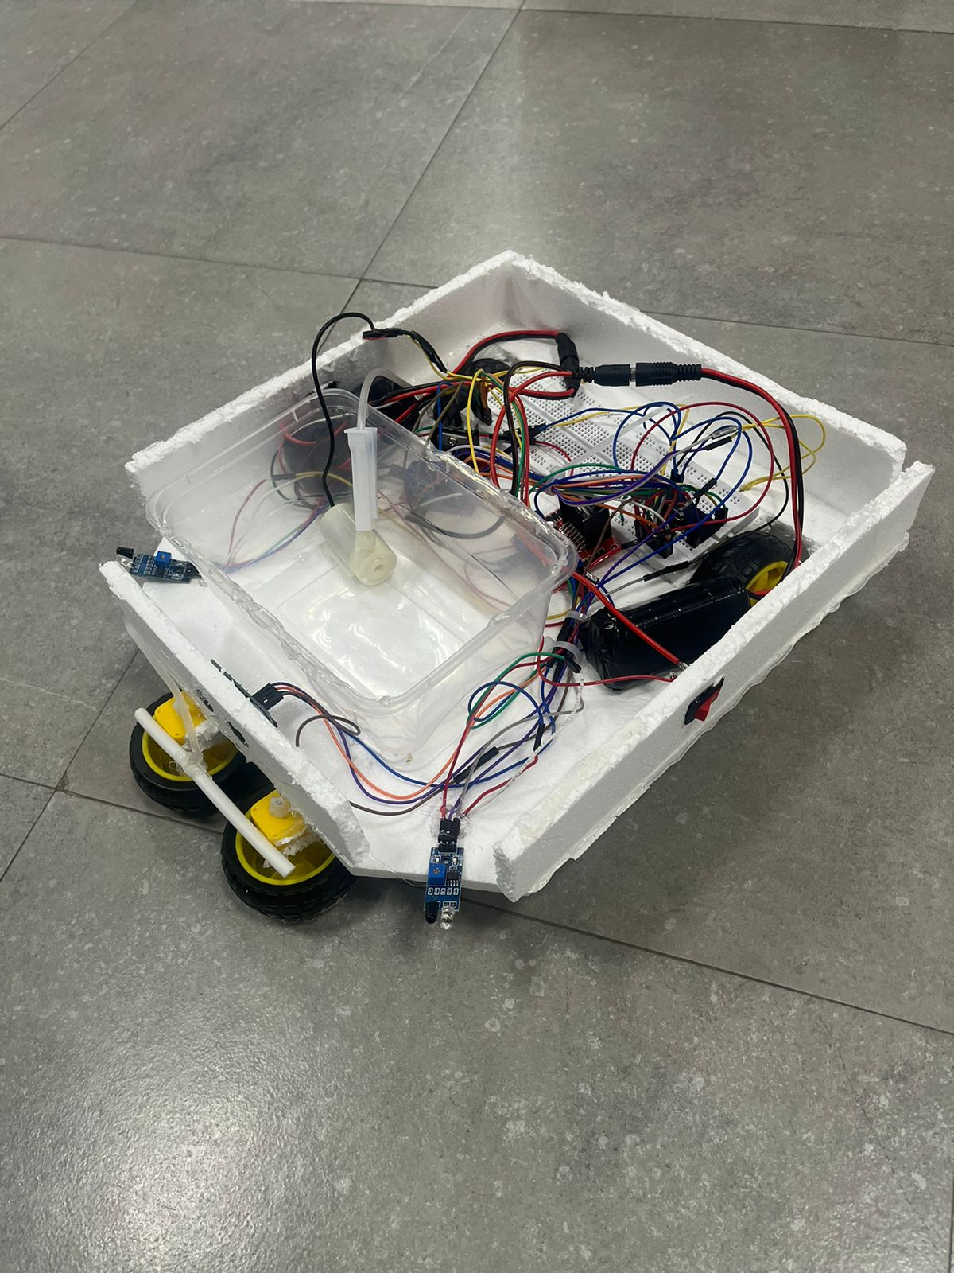
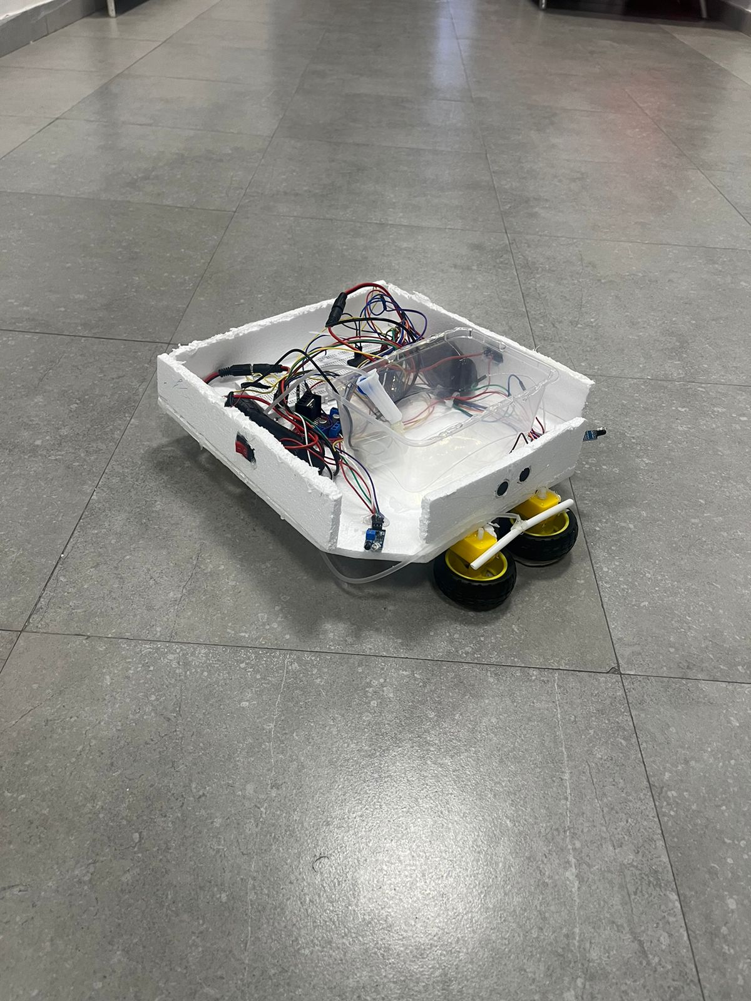
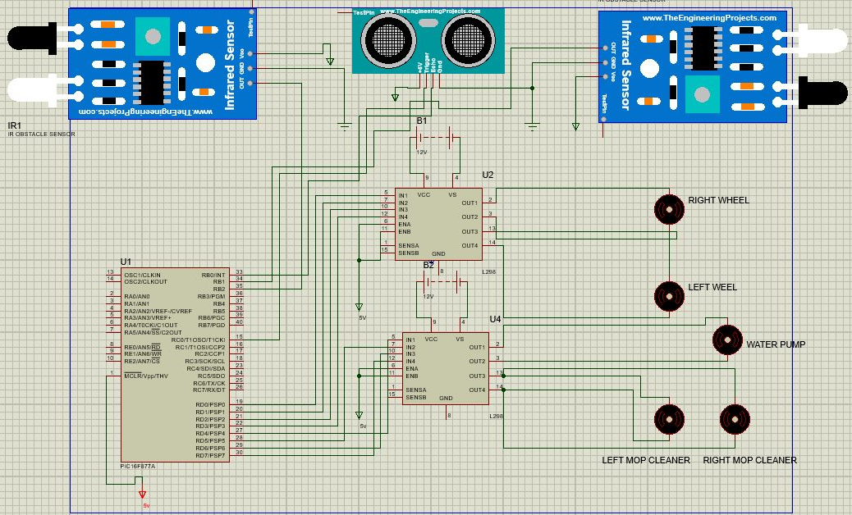
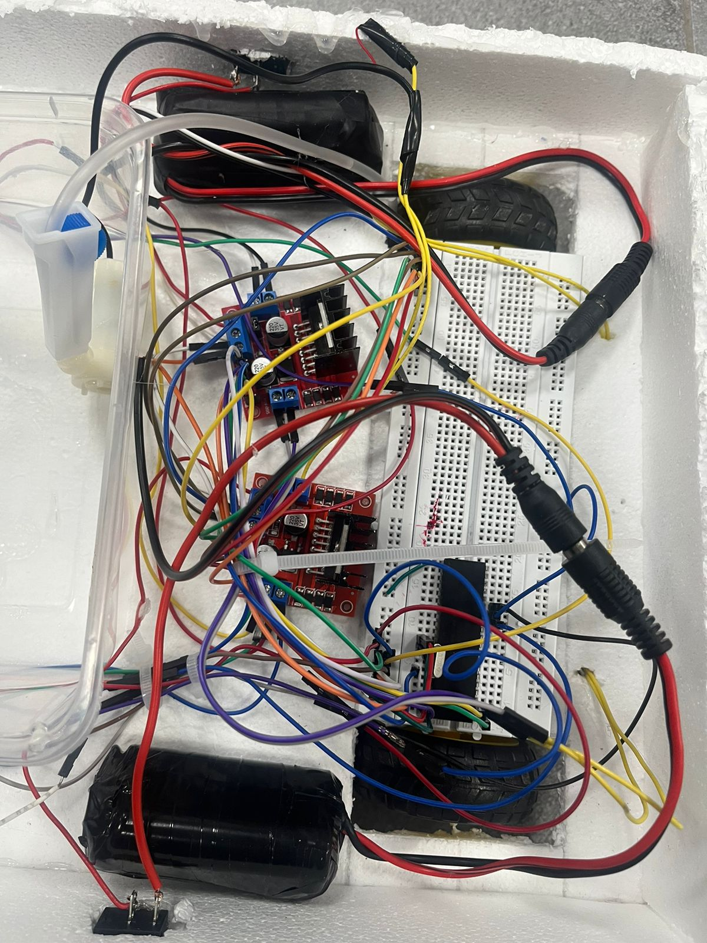
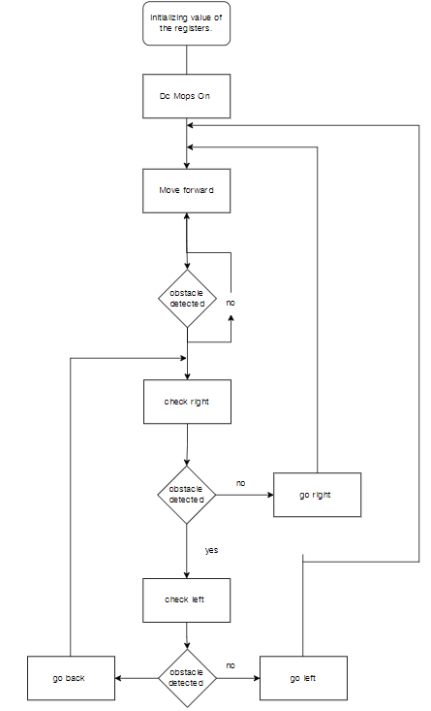
Automated mop cleaner
Jamal Al Hijawi, Omar Abass, Jack Dabour, and Abdullah Zaher
Supervisor: Dr. Belal Sababha
Embedded Systems Final Design Project, Spring 2023
King Abdullah II School of Engineering
Princess Sumaya University for Technology
Introduction
We created an automated mop cleaner which takes the hassle out of keeping your floors pristine the mop cleaner is equipped with ultrasonic and ir sensors to navigate. It effortlessly maneuvers around obstacles, ensuring uninterrupted cleaning.
The automated mop cleaner also offers you the ability to add your own detergent or cleaning solution.
Our motors are controlled by an two H-Bridges coupled with two 12 volts batteries , as well as two IR sensors and one ultrasonic sensor for obstacle avoidance we also utilized a water tank with a water pump which can be filled with a cleaning solution.
Results
We have been able to design a mop cleaner that can mop and clean floors , which also have the capability to avoid obstacles using one ultrasonic sensor and two IR sensors, the user can also customize the cleaning solution or detergent that will be sprayed on the floor by a water pump.
The design of the project is shown in the following figures.
Figure 3 left view Figure 4 right view
Figure 5 Top view
Design
The figures below shows the schematic and the flow chart of the design.
Figure 1 Electrical schematic of the connected ports with pic 16F877A
Figure 2 Flow chart
Conclusion
Overall, embedded systems are made to achieve our goals and make our life's much easier, our Automated Mop Cleaner represents a breakthrough in floor cleaning technology. With its ability to clean and mop residential and commercial floors, as well as the option to customize the cleaning detergent with your preferred scent, this innovative device offers a truly personalized and efficient cleaning experience.
After extensive testing, we have gained valuable insights and learned from our mistakes, allowing us to deliver the greatest performance in future.

